Slide 1


Cross-platform Mobile Development with C#
Xamarin and MvvmCross

Slide 2
The Future Is Mobile!
Facebook posts
Emails
Tweets
60 %
75 %
90 %
Bill Boorman, ATC 2012

Slide 3
Agenda
Introduction 10’ olb
Building the “Zühlke X-Platform Messenger” 40’ ssh/urb
Role playing
Live coding
Questions (concerning the app)
myBosch App: Experiences 5’ kwl
Zühlke as Xamarin’s Premium Consulting Partner 5’ kls
Discussion 20’
Wrap-up 5’ olb

Slide 4
Web, Hybrid or Native?
jQuery Mobile
PhoneGap
Xamarin
Criteria | Web | hybrid | native
User Experience |  |  | 
Performance |  |  | 
Offline capability |  |  | 
Hardware |  |  | 
Payment models |  |  | 
Multi-platform |  |  | 
Abstraction |  |  | 
Deployment |  |  | 

Slide 5
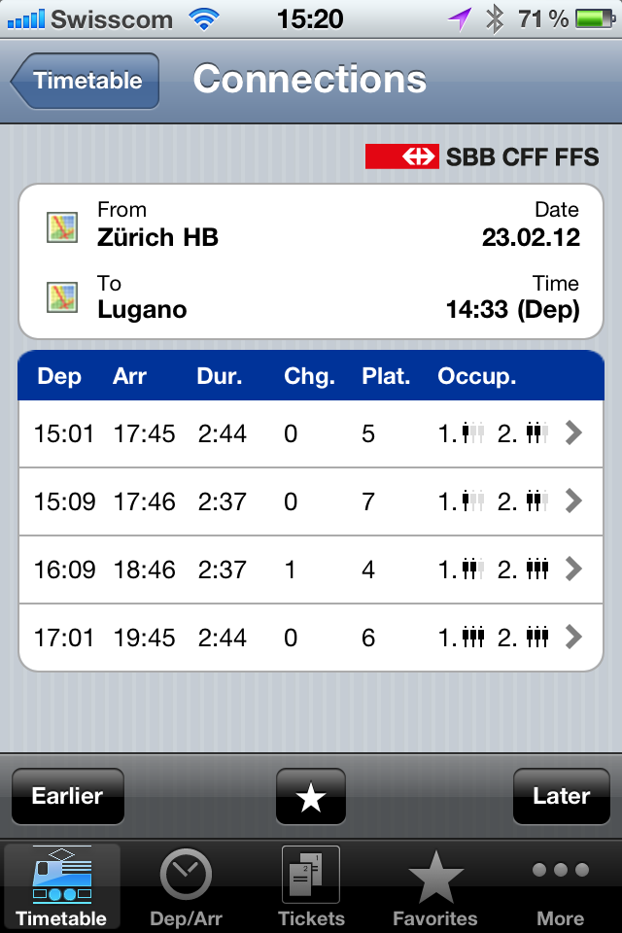
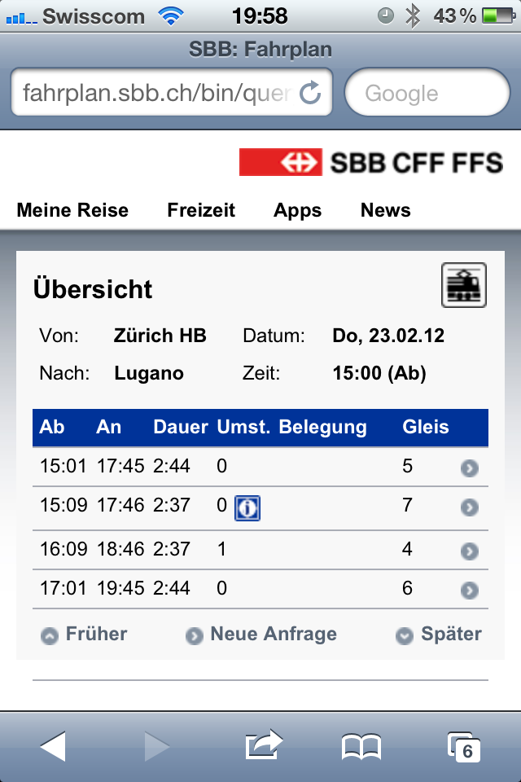
Example: Native vs. Web
Native
Web
Interaction elements
Deployment, updates
Offline capability (buy ticket)
Hardware support (shake for most recent ticket)
64 %
36 %
Mobile phone time
Nielsen, 2012
Notes:
Swiss Federal Railways
Train schedule

Slide 6



Code Sharing Using Xamarin and MvvmCross
Xamarin
MvvmCross
User Interface
User Interface
View
View
ViewModel
ViewModel
ViewModel
Model
Model
Model
Business Layer
Business Layer
Business Layer
Service (Azure)
HTTP
HTTP

Slide 7




Team Roles
Customer
Zühlke
Oliver Brack
Project Owner
Stefan Schöb
Android Developer
Windows
Ursin Brunner
iOS Developer
Mac OSX

Slide 8
Initial Position
.NET development team (C#)
Cloud service (Azure) providing a RESTful API
Get users
Send/receive messages
Zühlke X-Platform Messenger
Service (Azure)
Mobile Clients
Android
iOS
Business Layer (.NET) Portable Class Library
HTTP

Slide 9

Tooling Android
1
Visual Studio
Project types
Android simulator

Slide 10

Tooling iOS
2
Xamarin Studio
C# example
iOS simulator (remote)

Slide 11
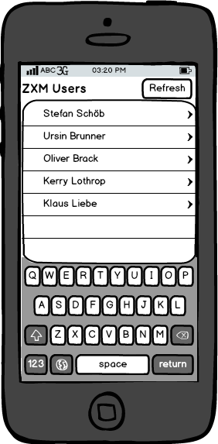
User Interface Mockup
Requirements
User list
Refresh button
Vision
User details
Messages

Slide 12
MvvmCross Setup with NuGet
3
Prepared solution
Zxm.Android: Android specific code
Zxm.Core: Shared code (client-side) as Portable Class Library (PCL)
Zxm.iOS: iOS specific code
Zxm.Test: Unit tests (client-side)
Zxm.Webservice: RESTful service (hosted on Azure)
NuGet → Install MvvmCross
HotTuna: Most recent release

Slide 13

Shared Model/ViewModel (1/2)
4
Model
User class
ViewModel
Derive from MvxViewModel
ObservableCollection for user list
ICommand to load/refresh users
View
View (xib) and ViewController (C#)
Table
Button
Data binding with MvvmCross classes/methods
Model
ViewModel
View

Slide 14

Shared Model/ViewModel (2/2)
5
User service access
RestClient (class from RestSharp)
Get users asynchronously
Deserializing JSON response with Json.NET
View (Android specific)
User list
Fragment (sub activity)
Layout for single user (XML)
Model
View

Slide 15
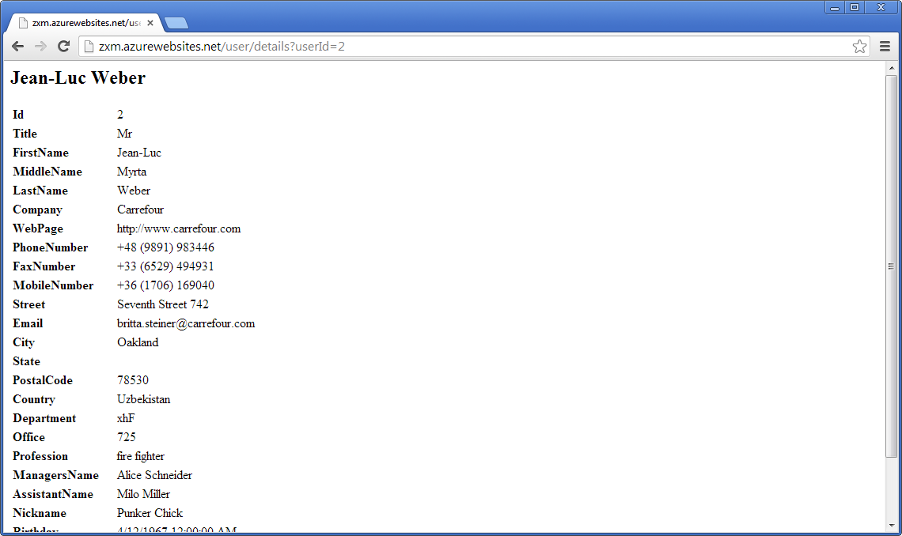
User Details

Slide 16
Including HTML5 Content
6
ViewModel
ViewModel
Create URL by user ID
ICommand to show user details (on UserListViewModel)
View
WebView (existing)
View

Slide 17
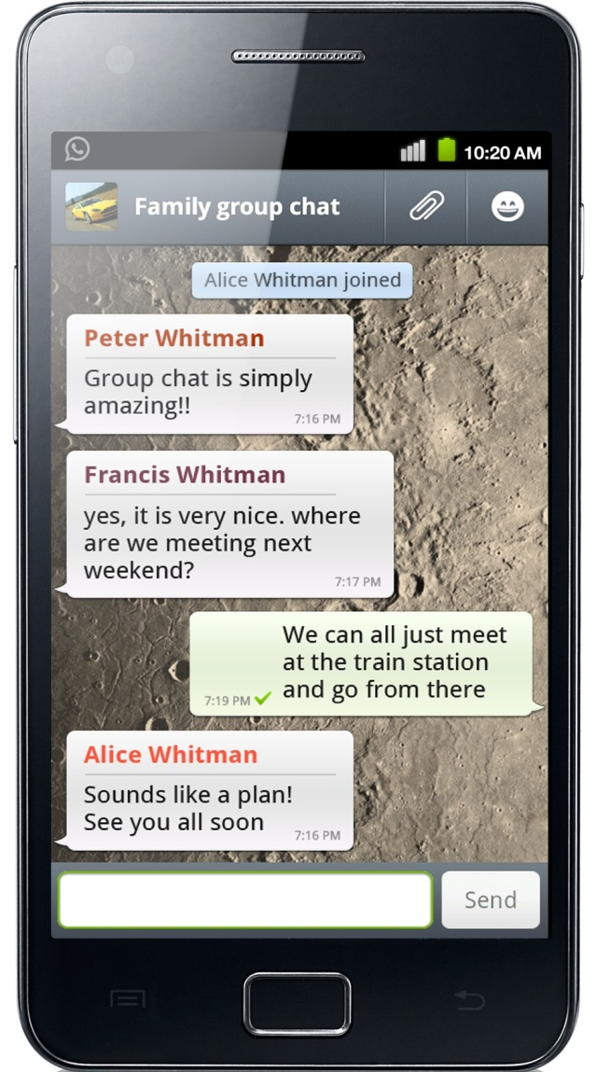
Messages
Requirements
Group chat
Every user can post messages
All users see whole message history

Slide 18
Messages
7
Core
MessageService (client-side) to receive and send messages
ViewModel
ObservableCollection for messages
ICommand to load/reload messages
View
Converter to convert timestamp (DateTime)
Menu item for Action Bar to send message
Model
ViewModel
Class diagram?
View

Slide 19

What About Security?
What about testing?
How can we ensure proper encryption/decryption?

Slide 20
Client-side Encryption
8
Encryption
Symmetric encryption with AES-256
Bouncy Castle implementation
Test Driven Development (TDD)
NUnit as test framework
NSubstitute for mocking
Test our EncryptedMessageService, not the encryption itself (as we are using a tested encryption library)

Slide 21
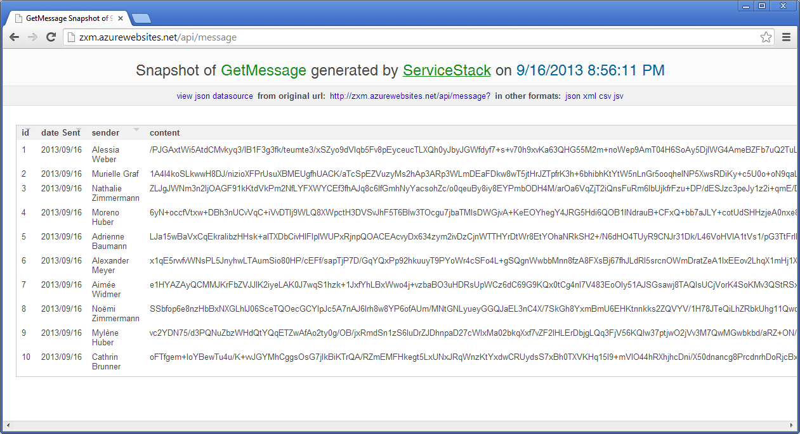
Service Hosting
Encryption demo on server
Service can be hosted on public Cloud (e.g. Azure)

Slide 22
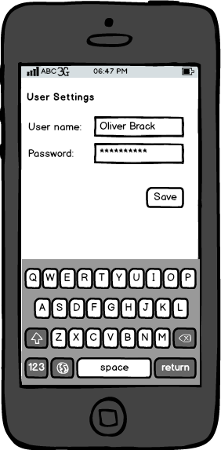
User Settings
Password (encryption key) hard coded
Reverse engineering
Key change needs deployment
Additional requirements
Settings
User name
Password
Individually configurable by user
Persisted independent from application

Slide 23
User Settings
9
SQLite database
Install SQLite using NuGet
Create DatabaseService (client-side) to access database
Full LINQ support to query/select/manipulate data
User settings
Service (client-side) to load/save settings
ViewModel revealing both username and password
Use password from user settings within encryption service

Slide 24
Code Metrics
3
Lines of code
Zxm.Android: ??
Zxm.Core: 396
Zxm.iOS: ??
Zxm.Test: 27
Zxm.Webservice: 279
?? % of code is shared

Slide 25

Questions (concerning the App)

Slide 26

myBosch App: Experiences
Kerry Lothrop

Slide 27

Zühlke as Xamarin’s Premium Consulting Partner
Klaus Liebe
Notes:
Zühlke is Xamarin‘s exclusive Premium Consulting Partner in the German-speaking world.

Slide 28

Discussion

Slide 29

About Us
Ursin Brunner
Software Engineer
Schlieren
Klaus Liebe
Business Unit Manager
Frankfurt
Stefan Schöb
Software Engineer
Schlieren
Kerry Lothrop
Lead Software Architect
Frankfurt
Oliver Brack
Nearshoring Manager
Belgrade

